Slide 1
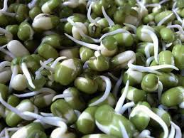
Kitchen Gardening
Growing
sprouts and MICROGREENS

Slide 2
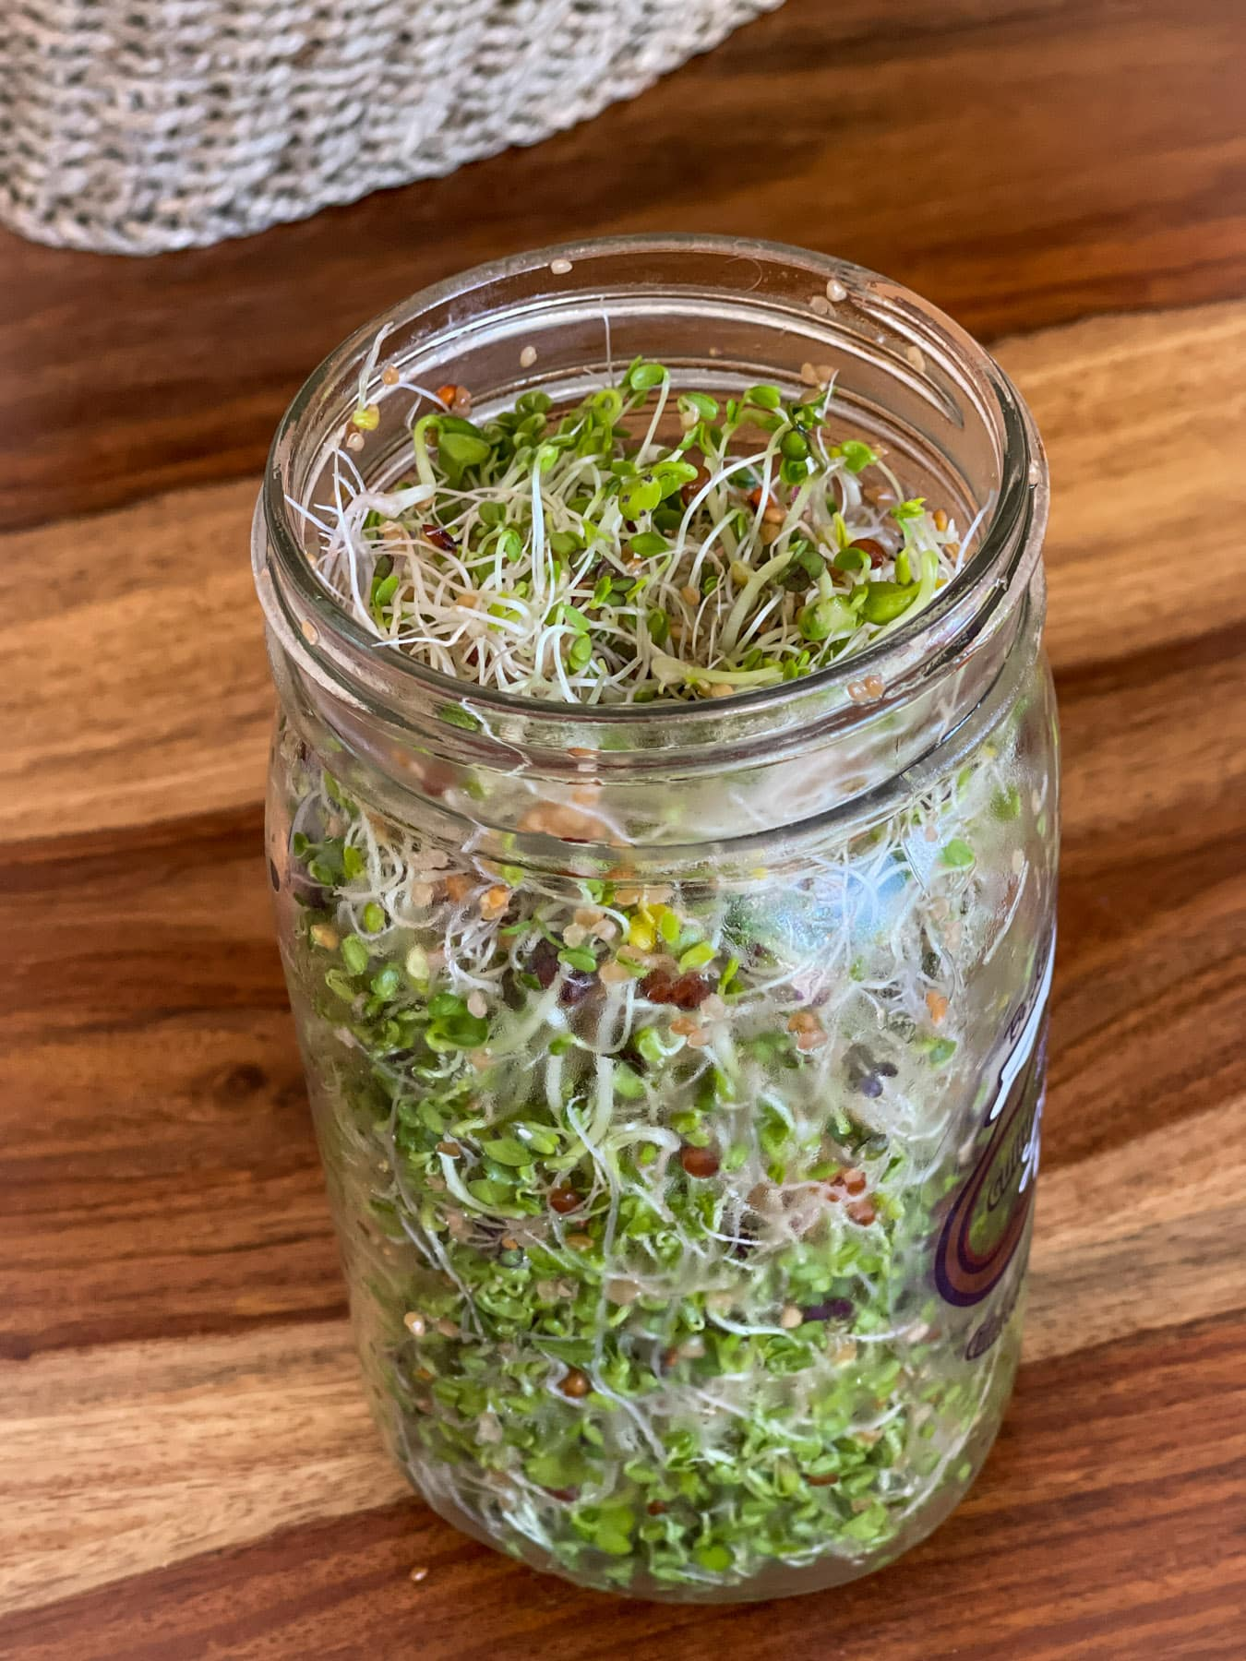
SPROUTS
Sprouts are young plants grown by germinating seeds in water for 2–7 days. They are harvested when the seed has just begun to sprout.
culturedfoodlife.com

Slide 3
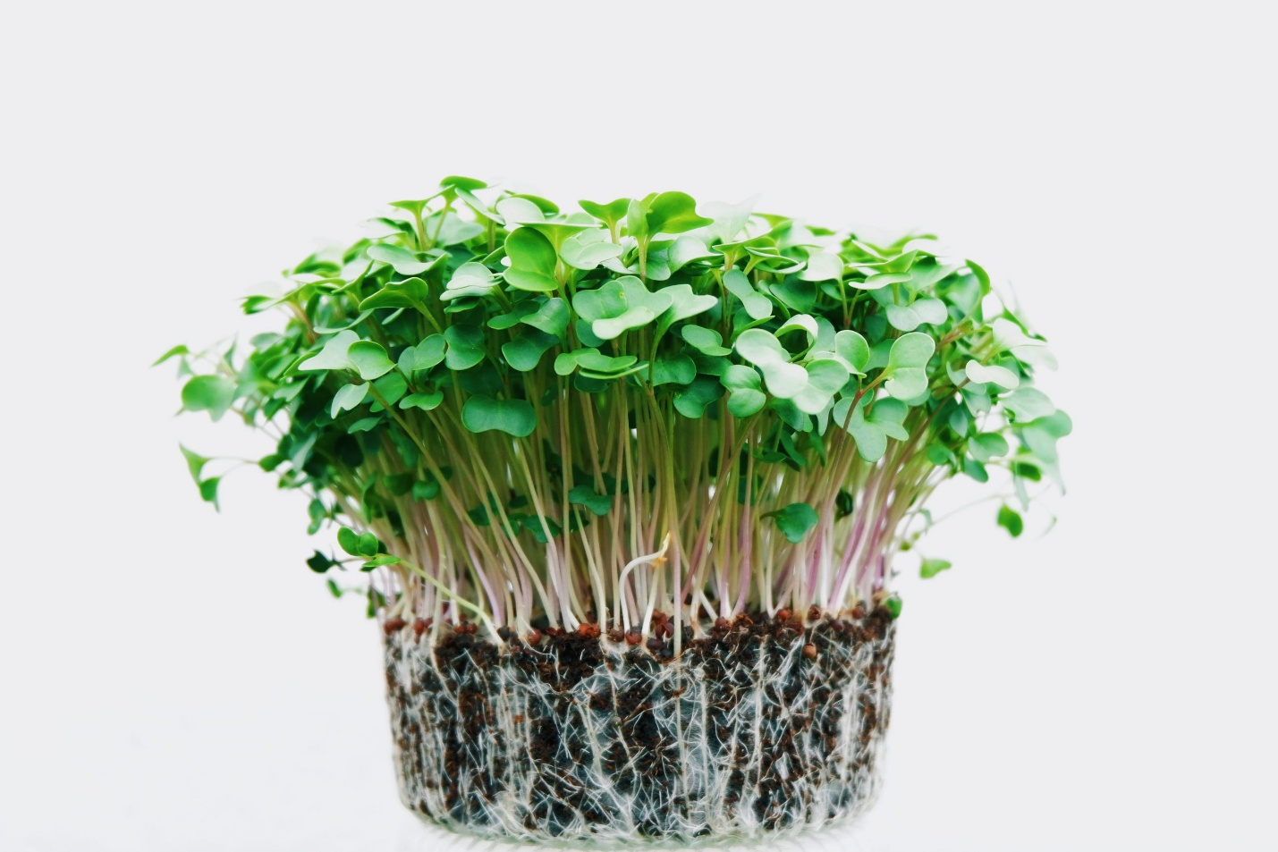
MICROGREENS
Microgreens are slightly older than sprouts and are grown in soil. They are harvested 7–21 days after germination, when their first true leaves appear.
Trueleafmarket.com

Slide 4


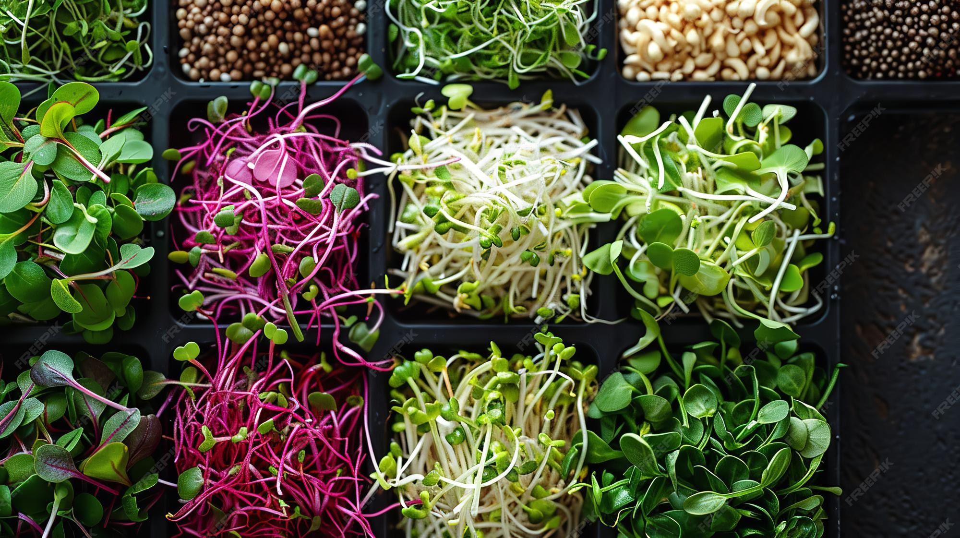
HISTORY OF SPROUTS and microgreens
Sprouts and microgreens have been included in the diet and medicine of dozens of cultures.
Ancient manuscripts show that by about 3000 B.C., the Chinese were eating both on a regular basis.
Captain Cook used sprouts to keep his sailors healthy from scurvy during long voyages.
There was a World War II campaign in the United States to grow sprouts.
freepik.com

Slide 5
HEALTH BENEFITS OF SPROUTS AND MICROGREENS
Every single sprout and microgreen contains all the amino acids to make it a complete protein.
Broccoli sprouts contain sulphoraphane, a cancer protective chemical (30-50 times more potent than in mature broccoli).
Regulate insulin levels in diabetics.
Reduce oxidative stress.
Anti-inflammatory.
Can detoxify the body of some pollutants.

Slide 6
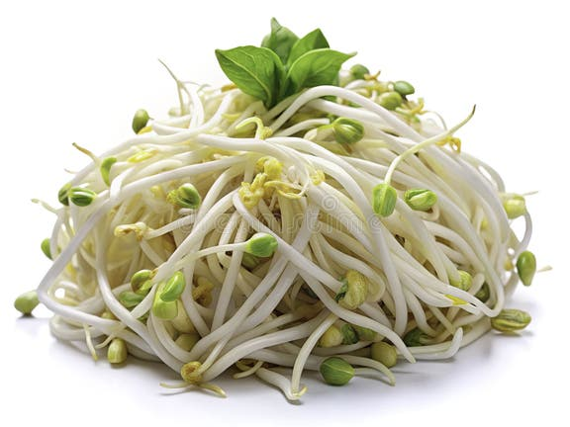
What are the health differences between sprouts and microgreens
Sprouts are beneficial for digestive health due to their high enzyme content which aids in digestion.
Microgreens have more fiber since they are an older plant and have a more developed stem.
Dreamtime.com

Slide 7
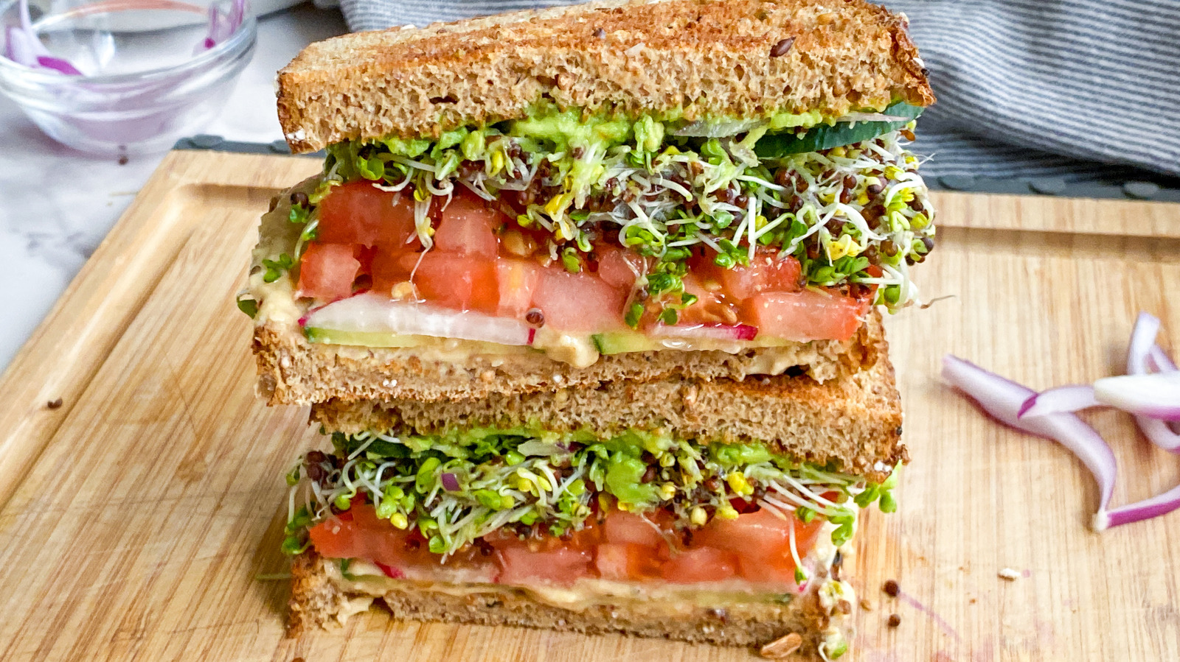
Recently, sprouts AND MICROGREENS have gained increased popularity. Today you can find THEM in supermarkets and in prepared sandwiches and salads.
Tastingtable.com

Slide 8
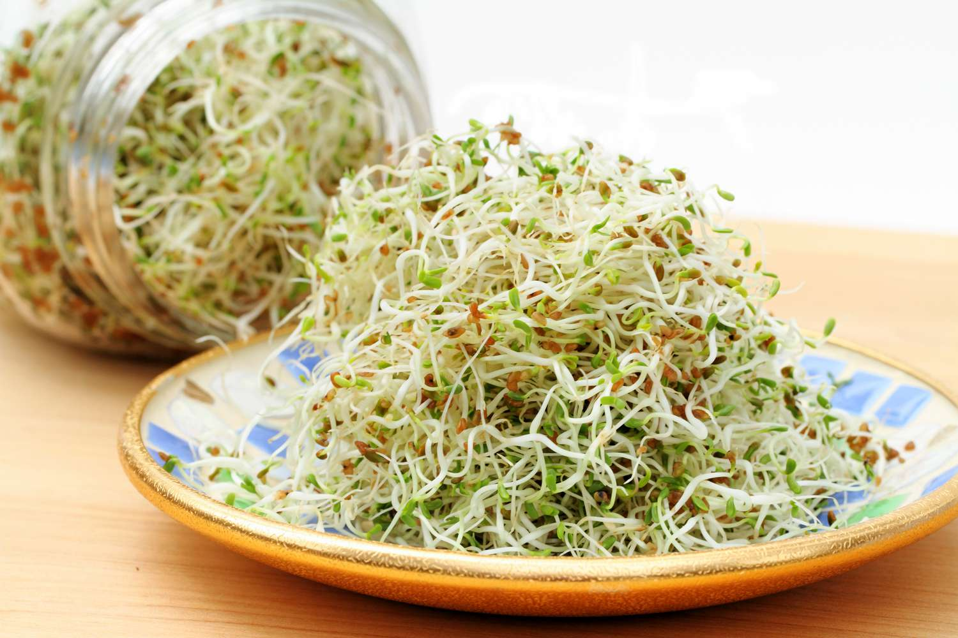
Growing Sprouts and microgreens Saves MONEY
Sprouts and microgreens are very economical to grow. Paying $4/lb. for seeds yields 26 cents per pound of fresh greens.
The Spruce Eats

Slide 9
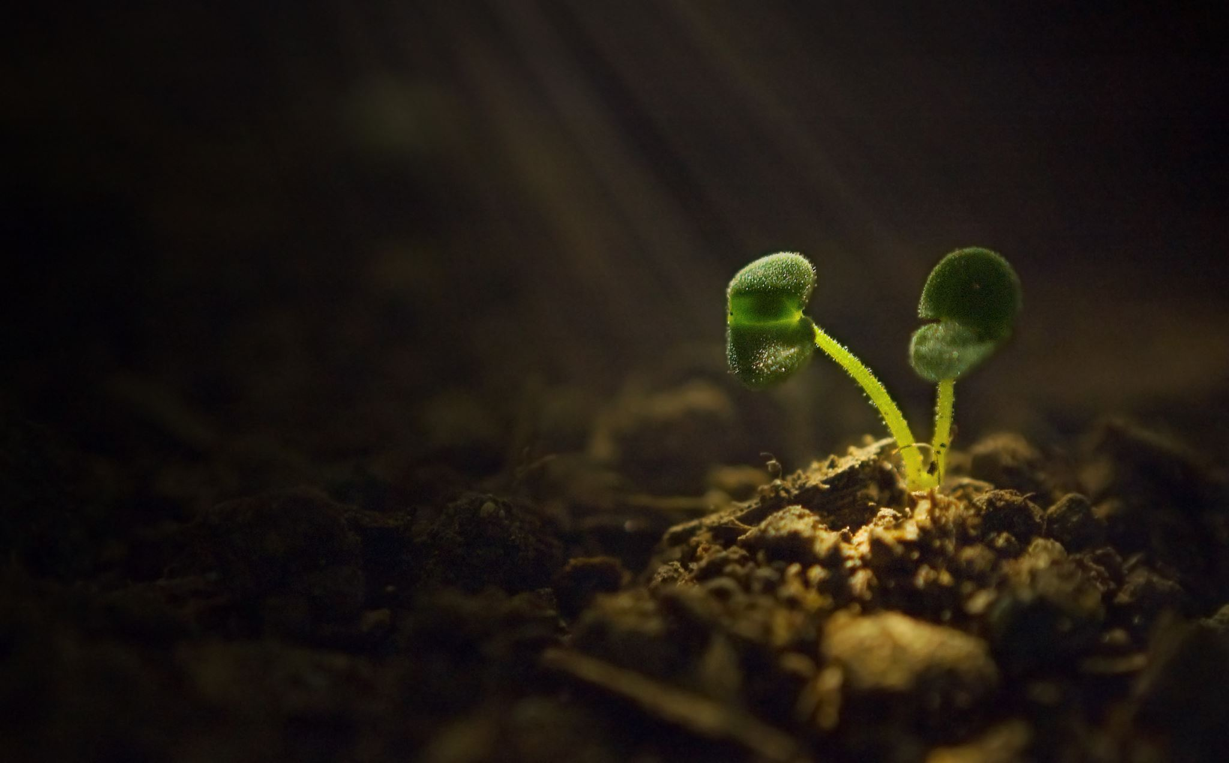
Seeds can be found and purchased in many places. It is best to purchase seeds designed for sprouting that are USDA organic and have been tested for high germination rates and pathogens.

Slide 10
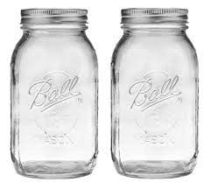
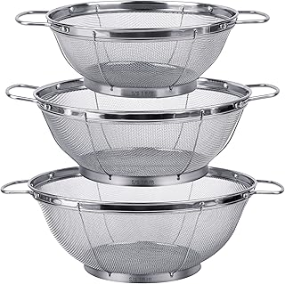
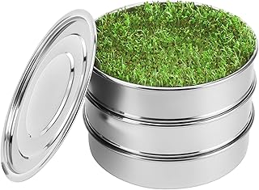
GROWING CONTAINERS FOR SPROUTS
Amazon.com

Slide 11
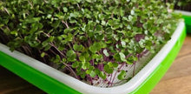
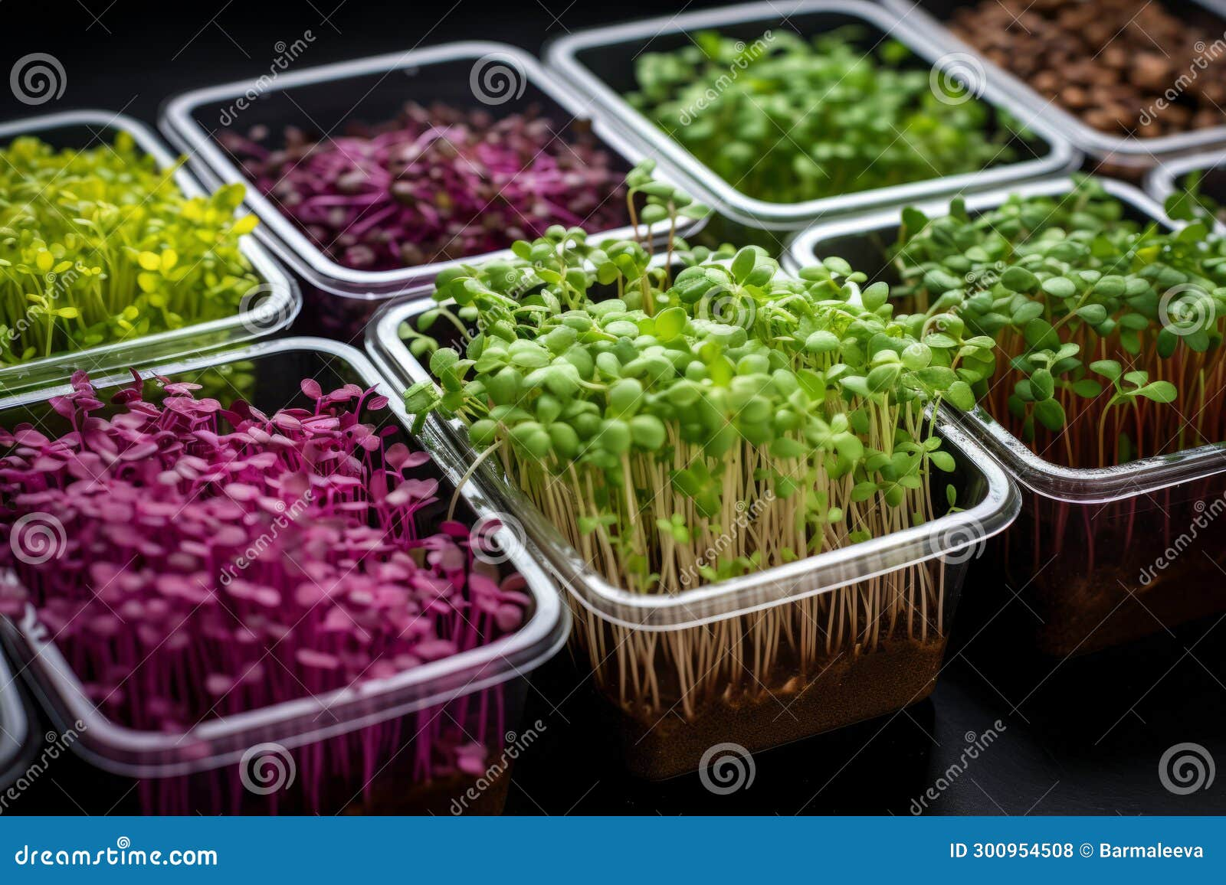
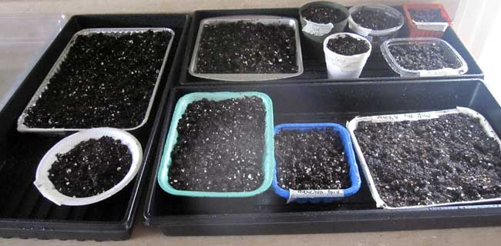
GROWING CONTAINERS FOR MICROGREENS
On the grow
dreamstime.com
idigorganics.com

Slide 12

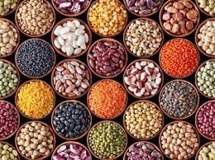
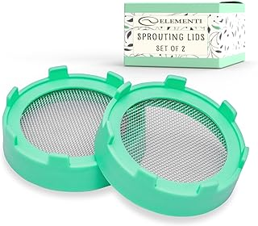
Sprouting essentials

Slide 13

Free App
THE SPROUTING COMPANY

Slide 14
Useful websites
THE SPROUTING COMPANY
SPROUTMAN

Slide 15
We have a choice today. We can eat healthfully with the best scientifically supported and protective foods to enable great health and protect ourselves from having a tragic future, or we can eat the worst diet ever available and have heart disease and strokes and get cancer. It’s up to you.
Joel Fuhrman, M. D.
Six-time New York Times bestselling author
DrFuhrman.com

Slide 16
Bibliography
Beerstecher, Jim. Beginners Guide to Growing Sprouts!
Evans, Dan. The Sprout Book.
Meyerowitz, Steve. Sprouts, the Miracle Food.
Wigmore, Ann. The Sprouting Book.
True Leaf Market. Complete Seed Sprouting Guide.
Sprouting Seeds for Food | VCE Publications | Virginia Tech (vt.edu)
Grow Your Own Sprouts in a Jar (treehugger.com)
Growing Seed Sprouts at Home (ucanr.edu)
Sulforaphane: What Is It, Its Benefits, & Top Foods & Supplements (foodrevolution.org)
The Health Benefits of Broccoli Sprouts (nutritionfacts.org)
.

