Slide 1
Methods:
Hügelkultur
Sheet Mulching
Mulch
Cover crops

Slide 2
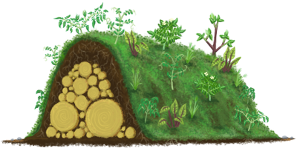

Slide 3
Hügelkultur (Hill Culture / Hill Mound)
How to say it:
HOO-gul-cool-TOOR
Origin: Germanic
TECHNIQUE
A mound constructed from decaying wood debris and other compostable biomass plant materials
HISTORY
Practiced by Germanic and European peoples for hundreds of years
Term “Hugelkultur” first appeared in 1962 publication by Herman Andra

Slide 4
CONSTRUCTION
Site Selection:
  Following contour of land and having 6-8 hours of sunlight per day
Typical Mound:
  3x5 feet / 3-5 feet in height
  Built in or above ground level
  Uses lasagna layer / sheet composting
Materials:
  Large logs (decaying)
    Avoid Black Walnut, Cedar, Black Locust, green cut trees, pressure treated wood
  Branches, small twigs, leaves
  Grass clippings, manure (Nitrogen rich sources)
  Compost, straw, shredded cardboard, topsoil, mulch
Building:
  Large logs first, followed by branches and twigs
  Fill spaces with layers of grass clippings, leaves, manure, kitchen waste, small twigs
  Compost / Topsoil
  Water each layer thoroughly and mulch to prevent erosion
Ready to plant!
  Veggies
    Loves Potatoes!
    Flowers / Herbs
Notes:
‹#›

Slide 5
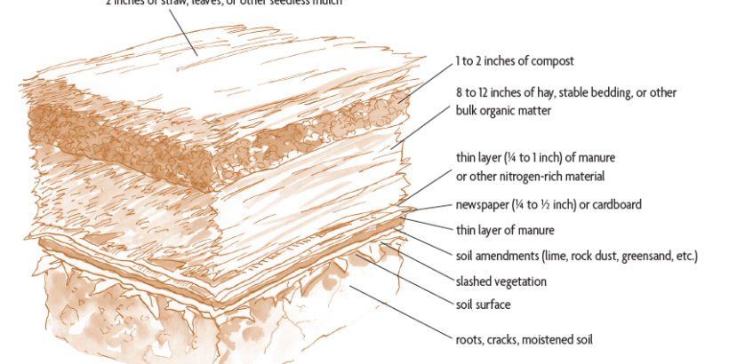
Sheet mulching

Slide 6
Simple Method
ADD a layer of
newspaper or cardboard,
old cloth / wool carpet
&
TOP with 1 ft of
ORGANIC MULCH

Slide 7
Ultimate Sheet mulch
Choose size and location:
200 square feet or less
6-8 hours of direct sunlight

Slide 8
MATERIALS
2-3 Feet of Stacked Newspaper (no glossy!)
OR
300 sq Feet Cardboard (remove staples and tape)
Soil Amendments; according to need and intention
(Lime, rock phosphate, bone meal & rock dust)

Slide 9
MATERIALS CON’T
Bulk Organic Material
4-8 cubic yards of loosely piled material
or
6-10 2-string bales of straw (covers 100-200 sq feet)
Straw, spoiled hay, yard waste, leaves, grass clippings
mixed with brown materials
  Compost ½ cubic yard
  6 cubic ft manure

Slide 10
Process
Water site well 1 day before construction
Cut down vegetation and leave in place
Add soil amendments
If native soil is compacted open with garden fork or broad fork
Add thin layer of high nitrogen material, ie manure, bloodmeal or fresh grass clippings. This layer helps attract worms and burrowing beetles that aerate soil.
Add newspaper / cardboard overlapping by 6 inches
Add another thin layer of nitrogen rich manure, meal or fresh grass clippings
Add bulk organic material 8-12 inches thick
Water (damp, not wet) approximately every 4 inches
Top with 1-2 inches of compost
Final layer 2 inches of weed and seed free organic matter
  (straw, fine bark, saw dust or pine needles)
YOU ARE READY TO PLANT!

Slide 11
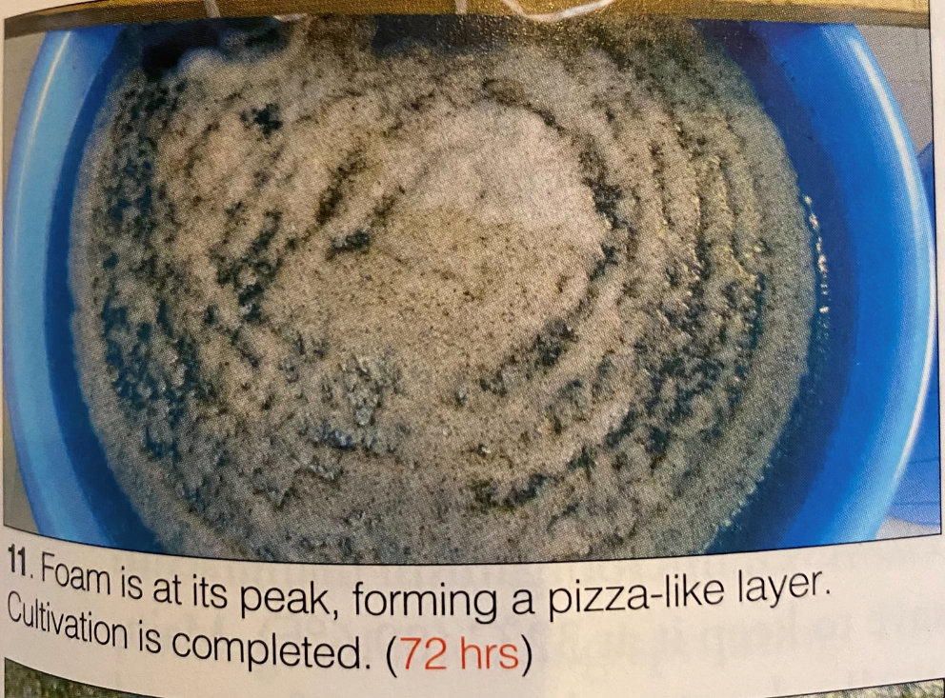
JADAM Microorganism Solution
Microbial Soil Drench
Hands-in-the-Dirt
Examples

Slide 12
Jadam Microorganism Solution
Promotes microbial activity in soil
Reduces soil salinity
Encourages strong root establishment
Prevents nematodes and wilting
Notes:
‹#›

Slide 13
Ingredients
4 gallons soft water (rainwater ok) | 1 medium boiled organic red or yellow potato | 1 gallon cloth paint strainer
15 grams fine sea salt | 20 grams leaf mold soil or Active Compost | 1 wooden stick
Notes:
‹#›

Slide 14
Process
Pour soft water / rainwater in 5 gallon bucket
Stir in fine sea salt
Mash boiled potato with fork, place in paint strainer
Add leaf mold soil to strainer
Attach to strainer to stick
Lower strainer into water solution and gently squeeze to incorporate
Position stick across bucket so that strainer is suspended in water
Cover and allow to ferment for 24 - 72 hours
Solution is ready when bubbles cover the surface
Notes:
‹#›

